Slide 1
ECR ECS

Slide 2
Amazon Elastic Container Registry (ECR)
is a fully-managed Docker container registry that makes it easy for developers to store, manage, and deploy Docker container images.
is integrated with Amazon Elastic Container Service (ECS), simplifying your development to production workflow.

Slide 3
Amazon Elastic Container Registry (ECR)
Benefits
Highly available
Amazon Elastic Container Registry has a highly scalable, redundant, and durable architecture.
Your container images are highly available and accessible, allowing you to reliably deploy new containers for your applications.

Slide 4
Amazon Elastic Container Registry (ECR)
Benefits
Fully managed
Amazon Elastic Container Registry eliminates the need to operate and scale the infrastructure required to power your container registry.
There is no software to install and manage or infrastructure to scale.
Just push your container images to Amazon ECR and pull the images using any container management tool when you need to deploy.

Slide 5
Amazon Elastic Container Registry (ECR)
Benefits
Secure
Amazon Elastic Container Registry transfers your container images over HTTPS and automatically encrypts your images at rest.
You can configure policies to manage permissions and control access to your images using AWS Identity and Access Management (IAM) users and roles without having to manage credentials directly on your EC2 instances.

Slide 6
Amazon Elastic Container Registry (ECR)
Benefits
Simplified workflow
Amazon Elastic Container Registry integrates with Amazon ECS and the Docker CLI, allowing you to simplify your development and production workflows.
You can easily push your container images to Amazon ECR using the Docker CLI from your development machine, and Amazon ECS can pull them directly for production deployments.

Slide 7
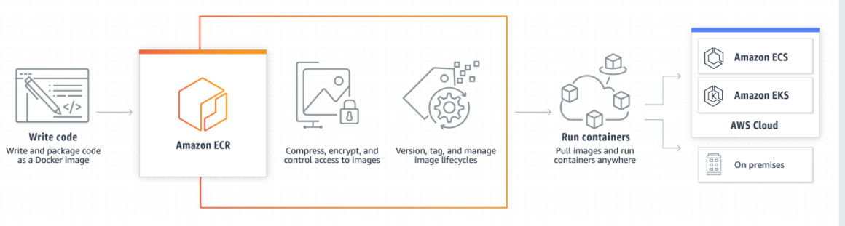
Amazon Elastic Container Registry (ECR)
How it works

Slide 8
Amazon Elastic Container Service
Amazon Elastic Container Service (Amazon ECS) is a fully managed container orchestration service.
Customers such as Duolingo, Samsung, GE, and Cookpad use ECS to run their most sensitive and mission critical applications because of its security, reliability, and scalability.

Slide 9
Amazon Elastic Container Service
Benefits
ECS is a great choice to run containers for several reasons.
First, you can choose to run your ECS clusters using AWS Fargate, which is serverless compute for containers.
Fargate removes the need to provision and manage servers, lets you specify and pay for resources per application, and improves security through application isolation by design.
Second, ECS is tested extensively for security, reliability, and availability.

Slide 10
Amazon Elastic Container Service
ECS supports Fargate to provide serverless compute for containers.
Fargate removes the need to provision and manage servers, lets you specify and pay for resources per application, and improves security through application isolation by design.

Slide 11
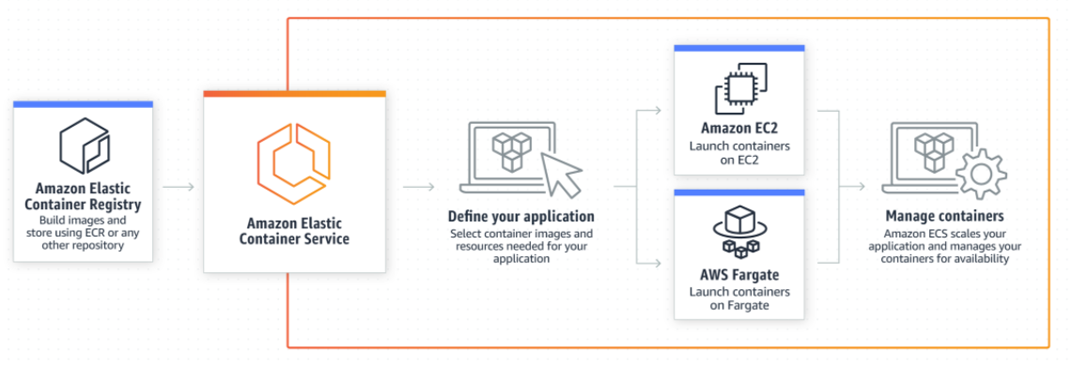
Amazon Elastic Container Service
How Amazon ECS works

Slide 12
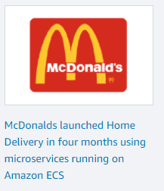
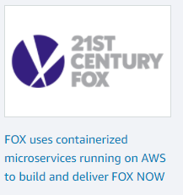




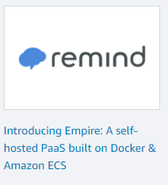
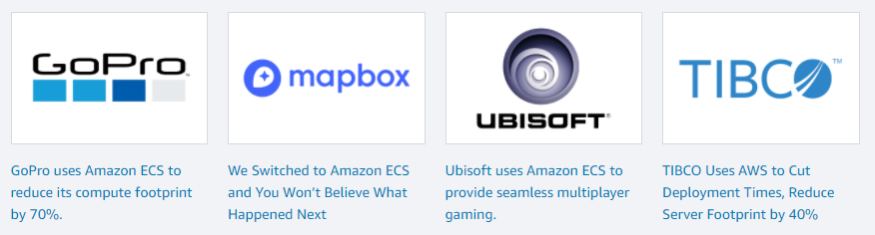
Amazon Elastic Container Service
Customers Using Amazon ECS

